Slide 1
McNary 2016

Slide 2
Fish VS Birds
Comparison Graphs

Slide 3
Chinook (yearling)
Steelhead
Coho
Sockeye
Chinook (sub-yearling)

Slide 4
Chinook (yearling)
Steelhead
Coho
Sockeye
Chinook (sub-yearling)

Slide 5
Piscivorous Birds
and Lamprey
Comparison
Graphs

Slide 8
Piscivorous
Bird Graphs
McNary’s birds included in graphs: GULL, AWPE, CATE & DCCO

Slide 14
John Day
and
McNary Comparison
Graphs
Data from John Day courtesy of Erik Grosvenor

Slide 15
McNary Avian Zones

Slide 16
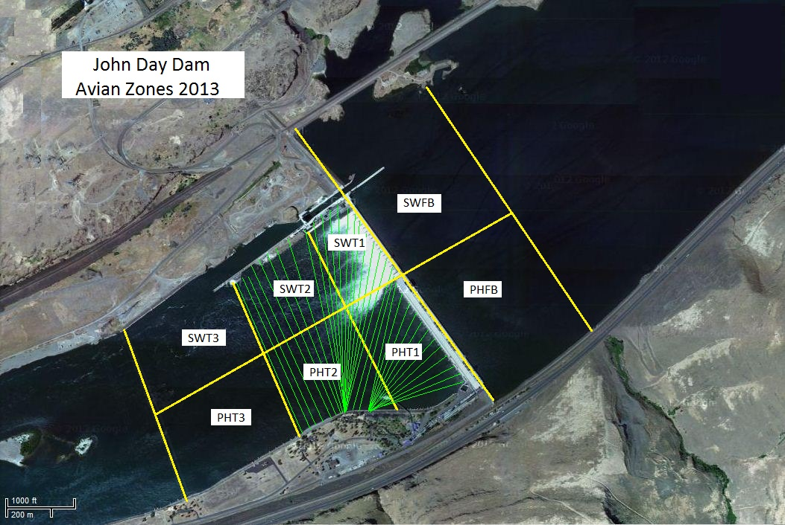

Slide 21
Double Shifts Began

Slide 23
Individual Groups Broken
Down
(Watch Scale)

Slide 32
Gull Graphs by Zone

